Slide 1
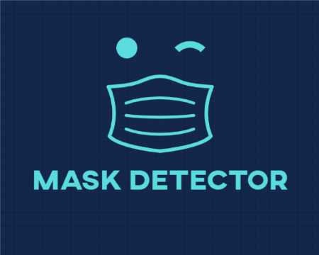

Slide 2





Welcome To MASK DETECTOR
Set Up Device Outputs
User Instructions
Exit

Slide 3




Visual
Set Up Device Outputs
Audio
Change Alert Settings
Output Level:
Test Speaker
Speaker:
Camera:

Slide 4
Visual
Set Up Device Outputs
Audio
Change Alert Settings
Output Level:
Test Speaker
Speaker:
Camera:

Slide 5
Visual
Set Up Device Outputs
Audio
Change Alert Settings
Output Level:
Test Speaker
Speaker:
Speaker:
Camera:
Speaker 1
Speaker 2
Speaker 3

Slide 6
Visual
Set Up Device Outputs
Audio
Change Alert Settings
Output Level:
Test Speaker
Speaker:
Speaker:
Camera:
Camera 1
Camera 2

Slide 7

Alert Settings
Select tone:
Voice – Man (Eng) (Deafult)
Voice – Woman (Eng)
Voice – Man (Heb)
Voice – Woman (Heb)
Alert 1
Alert 2
Alert 3
Alert4
Upload new tone :
Upload
We support the following file formats: mp3, aac, wac, flac .
Disable sound

Slide 8

User Instructions
About Us
We are four Computer Science students from Hebrew University of Jerusalem, that came together to create a free solution for identification and notification of citizens who are not wearing face-masks.
Stay Healthy and Safe,
Alon, Bar, Or & Ziv.
How To Use The Application
On the Main Menu page click on the ‘Set Up Device Outputs‘ option to set up and test the system speaker and camera.
On the Set Up Device Outputs page, select the desired speaker and camera. Verify that the output devices work properly by clicking on ‘Test Speaker’, and by viewing the chosen camera’s output appear.
You may want to change the default notifications sounds preferences. To do so, on the Set Up Device Outputs page click on the ‘Change Alert Settings’ option.
On the Change Alert Settings page chose the tone. Marking a specific tone will play it for you to hear.
On the Main Menu page, click ‘ACTIVATE’, this will activate the software from you device. The camera’s output will be shown on you screen.
You can always navigate back to the previous location by clicking the arrow on the top right corner of the screen.
About The Application This is an offline application, designed to be placed in a public place or an institution’s entering point and notify whether a person is wearing a mask, both visually and vocally The system requires a camera, a screen (to display visual instructions to the passers-by: optional) and a speaker (to notify the passers-by: optional), and uses a Machine Learning techniques to analyze the streamed video. In this experimental version the software detects only one person at a time.

Slide 9



Slide 10
Thank You For Using MASK DETECTOR

